Slide 1
MAR 530: Ecosystem Based Fisheries Management
Lecture 4
Types of advice, decision theories, goal-setting
www.mycourses.umassd.edu
20 February 2015

Slide 2
Today’s Outline
Project topics discussion
Triage
Kinds of management advice
Decision theory
Goal-setting
Discussion on:
Tear et al 2005
Francis et al 2007
Garcia & Cochrane 2005
Mangel et al 1996

Slide 3
One Main Theme Throughout Course
CONFRONTING TRADEOFFS

Slide 4
Simplified Schedule
Week | Theme | Topic
1/30 | Context | Introduction, What is EBFM?
2/6 |  | Challenges facing fisheries, what can EBFM offer?
2/13 |  | Guest lecture: case studies of EBFM
2/20 |  | Types of advice, decision theories, goal-setting
2/27 | Operational | Bycatch, habitat, and spatial management
3/6 |  | Ecosystem indicators
3/13 |  | Extended single-species and multispecies models
3/20 |  | SPRING BREAK
3/27 |  | Aggregate and system models
4/3 |  | Ecological risk assessment
4/10 | Institutional | Societal and economic considerations
4/17 |  | Governance and management institutions
4/24 | Holistic | Evaluating tradeoffs
5/1 |  | Moving towards ecosystem based management
5/13 |  | Final exam: Project Presentations

Slide 5
Class project topics

Slide 6
Class project topics
Emphasize all three of:
Ecosystem-based
Fisheries
Management
Look for a body of literature to write from.

Slide 7
Triage

Slide 8
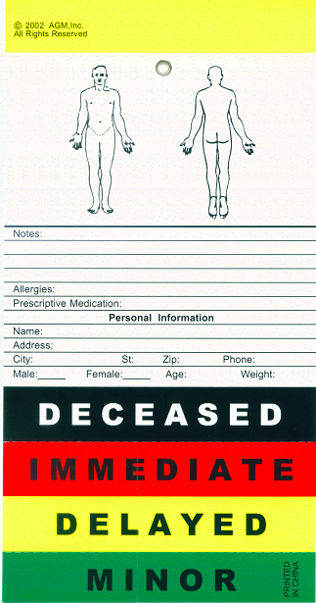
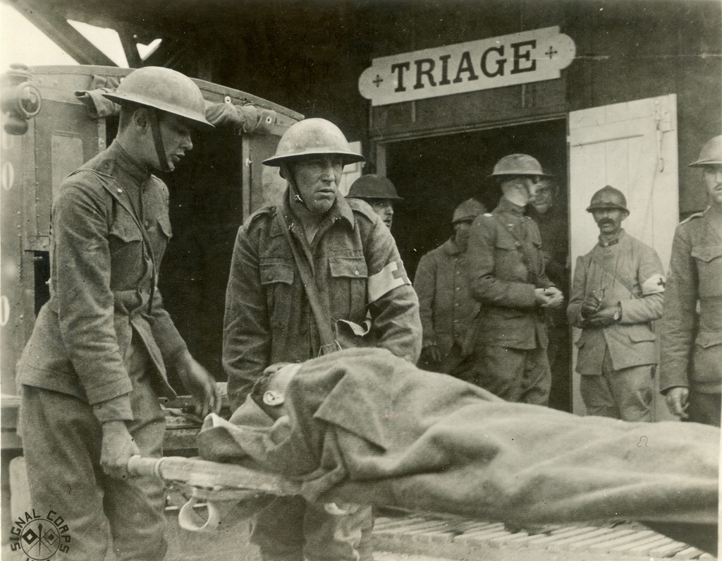
Triage
(in medical use) the assignment of degrees of urgency to wounds or illnesses to decide the order of treatment of a large number of patients or casualties.

Slide 9
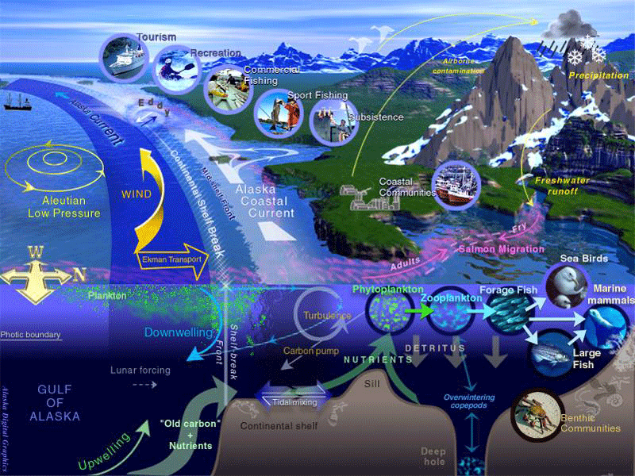
Triage
The art of figuring what is most critical to deal with, in order of priority…

Slide 10
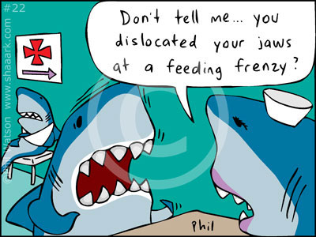
Triage
In an EBFM context, what do you think is/are the point(s) of a triage exercise?

Slide 11
Possible categories of ecosystem triage
Geography of the ecosystem
Key species
Abiotic factors
Species interactions
Aggregate properties
System level properties
Fisheries context

Slide 12
Kinds of Management advice
There are generally 3 levels of advice in a natural resource management context.
Heuristic
Strategic
Tactical

Slide 13
Heurism
Understanding ecosystem functioning
Relative importance of different processes
Advancing scientific theory

Slide 14
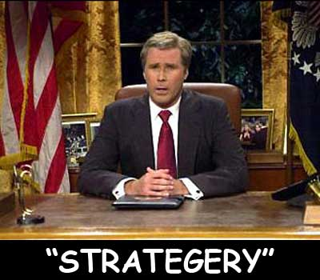
Strategic management
Assessing biomass tradeoffs
System level emergent properties
Evaluating major processes
Alternate stable states
Long term recruitment bottlenecks
General “What If” scenarios and gaming, long term trends
What needs to be done
BOUNDING IN SCOPE

Slide 15
Tactical management
Revised stock assessments
Yield adjustments
Biological reference points, etc.
Direct impacts on target, non-target species, protected species, habitat, aggregate groups
Specific “What If” scenarios and gaming
How to do what needs to be done.
BINDING IN SCOPE

Slide 16
Remember the level
Heuristic, Tactical, Strategic
What is the issue at hand?
Effects of fishing on other ecosystem properties
Effects of ecosystem on fishery
Need to have entire, integrated systemic view
Already have the specific, reductionist view.

Slide 17
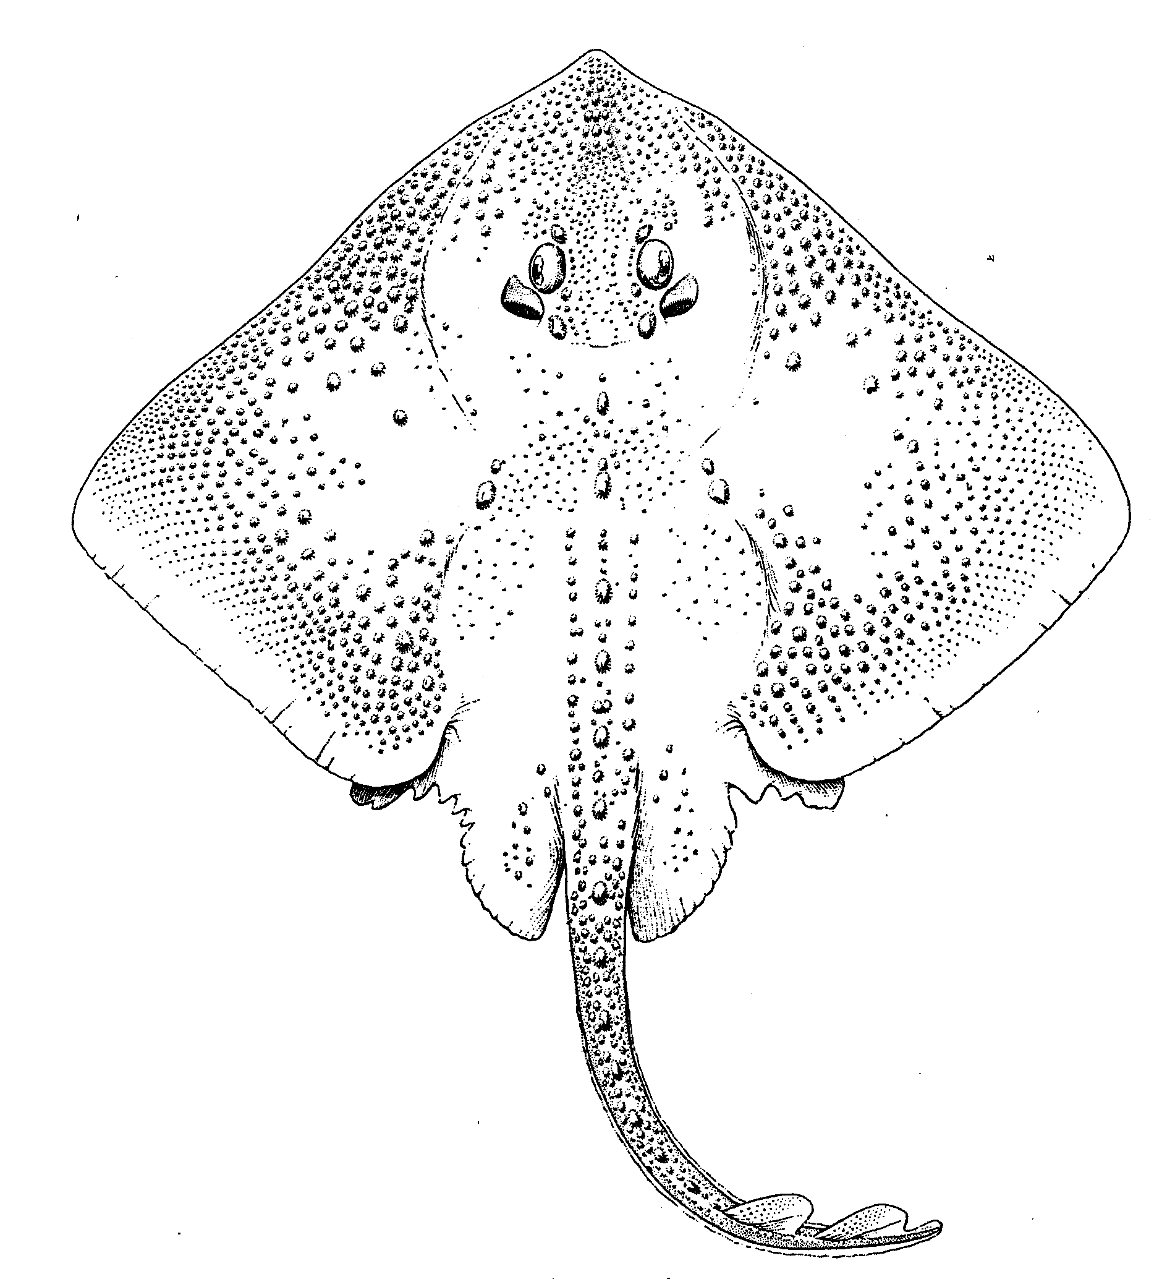
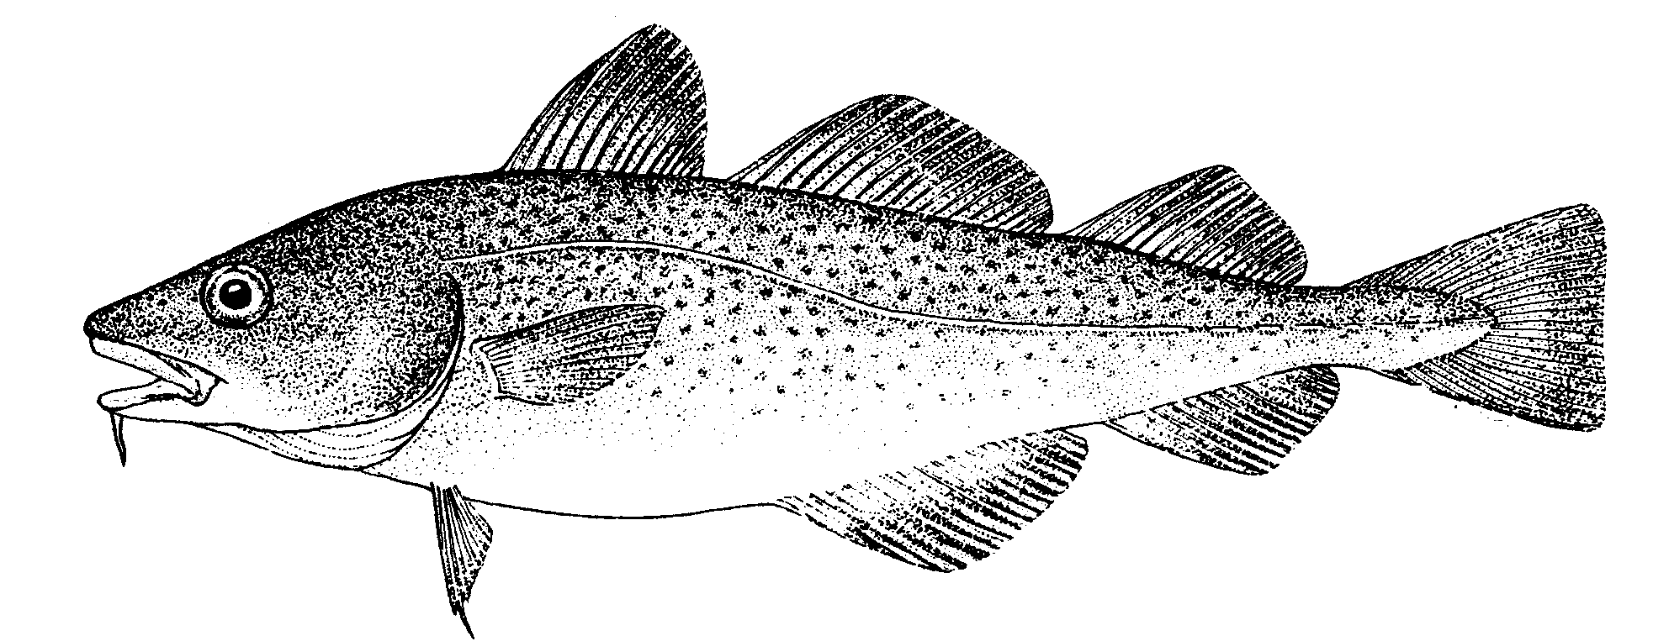
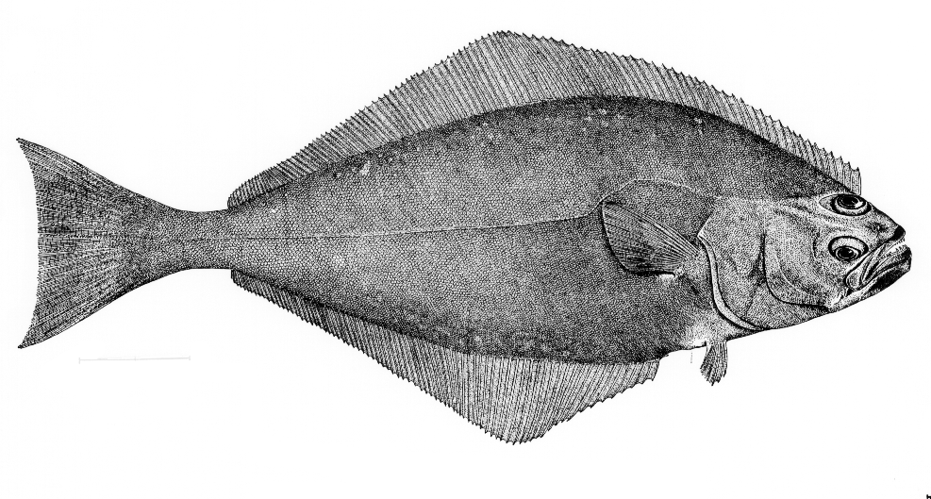
Appropriate tool might depend on level of advice required
Can Control & Measure Fishing Effort
Realism
Parsimony
Addresses Ecosystem Issues
Existing Methods and Metrics
Data Requirements (=Cost)
Stock/Single Species
Multi-species
Aggregate Biomass
Ecosystem
Messy Picture Here
Gadids
Pelagics
Flatfish
Predation, Competition, Mutualism, etc.
Habitat, Climate, etc.
Disease, Genetic Diversity, Fecundity, Migration, etc.
Technical Interactions

Slide 18
Kinds of management advice
“Managers usually ask for tactical advice, scientists usually give heuristic advice, when typically strategic advice is what is usually needed.”
Anonymous
“No strategy was a strategy last time…”
Stephen Colbert

Slide 19



Link’s Three Pillars
1. Goal Setting (Priorities & Allocation of Biomass)
2. Assessing [Ecosystem] Status (Multivariate metrics)
3. Achieving [Ecosystem] Goals (Management Tools)

Slide 20
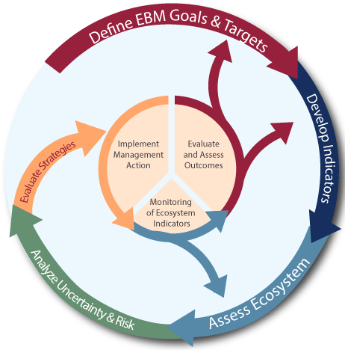
NOAA Fisheries IEA program

Slide 21

1. Ecosystem Goals
Address biomass tradeoffs
Holistic considerations
Evaluate sustainability of the current state or “obtainability” of the desired state
Need to have goals clearly defined, not altruisms (“unpacking” from high levels)
Explore multiple, viable options
Be inclusive of all possible stakeholders
Develop institutions and protocols to settle competing goals

Slide 22
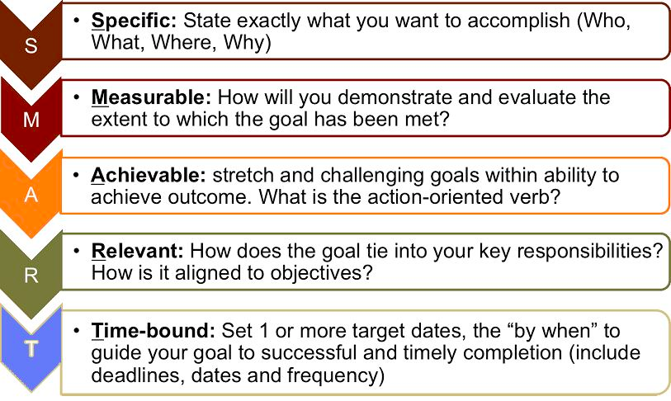
Translate ecosystem goals into SMART objectives
hello

Slide 23
Translate ecosystem goals into SMART* objectives
*Specific, Measurable, Achievable, Relevant, Time-bound
Match objectives to indicators
Evaluate indicators using established criteria

Slide 24
Ecosystem-level Management Objectives
Conservation
Biomass and productivity of harvested and other species are healthy. Trophic structure is healthy, and habitat integrity is conserved.
Socio-economic
The flow of benefits from ocean resources, for both producers and consumers, is optimized given the other objectives.

Slide 25
SMART socio-economic objective
Define “benefits” (from US fishery legislation)
Food
Recreation
Profits/Revenue
Employment
Stability
Define “producers and consumers”
Define “optimize” (from US fishery legislation)
Greatest overall benefit to the Nation <= fishery MSY
Subject to conservation objective constraints

Slide 26
2. Assessing Ecosystem Status
Multiple metrics
Biotic (resource and non resource)
Abiotic
Human
Long time series (?)
Modeling
Novel ways to package the information

Slide 27

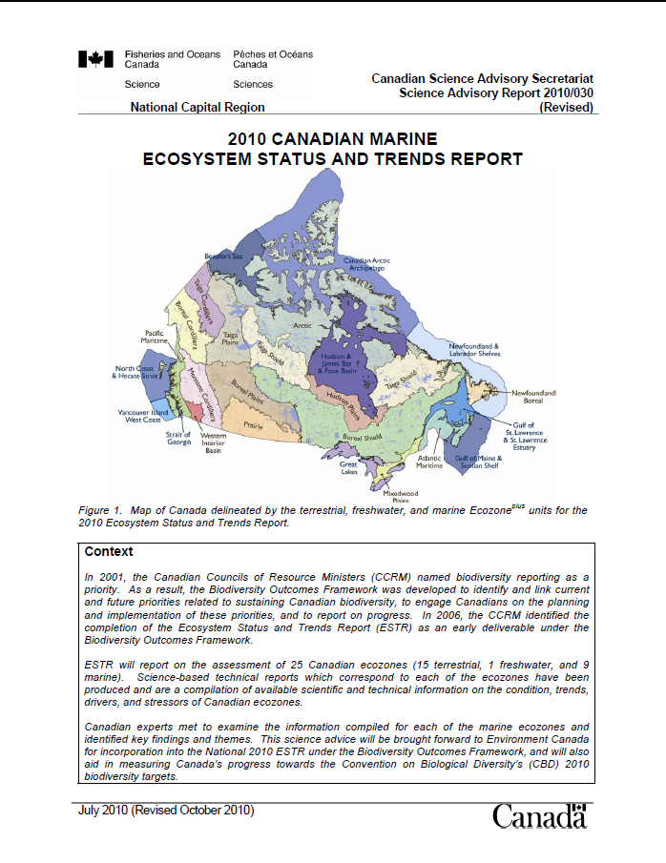
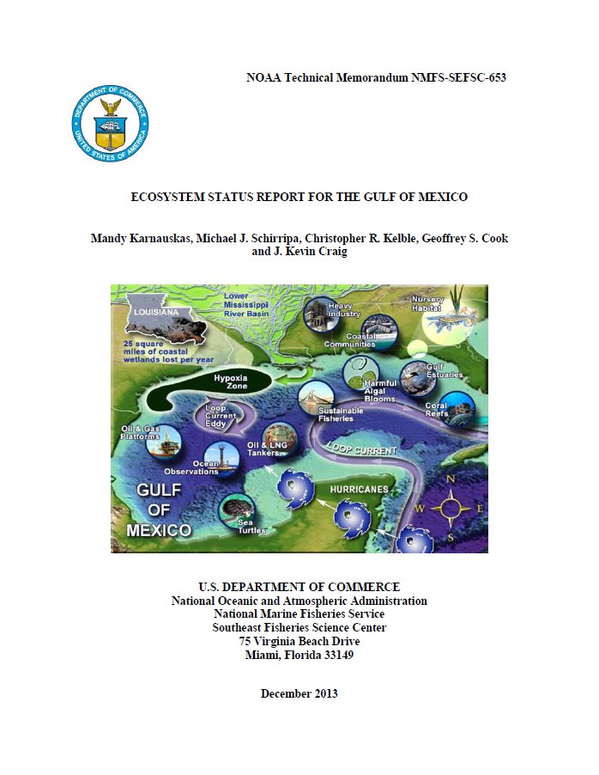
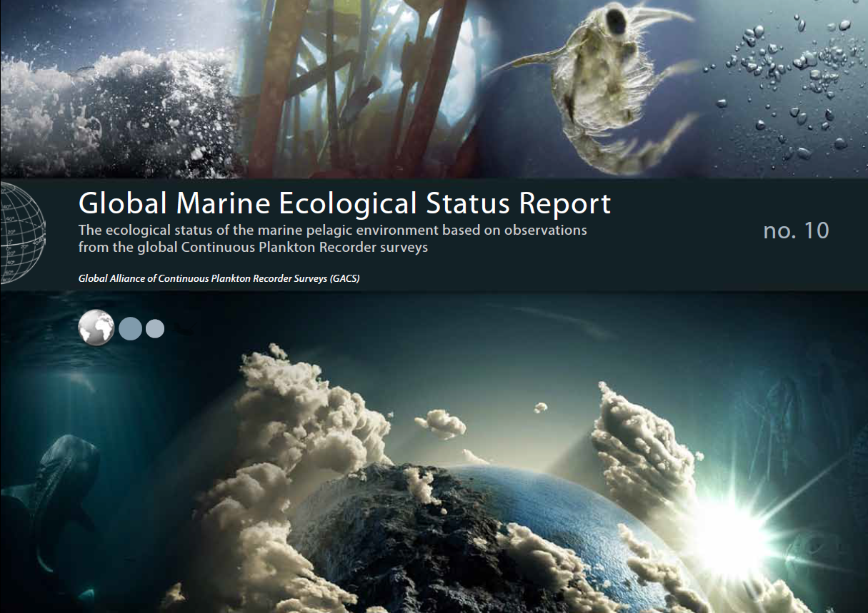
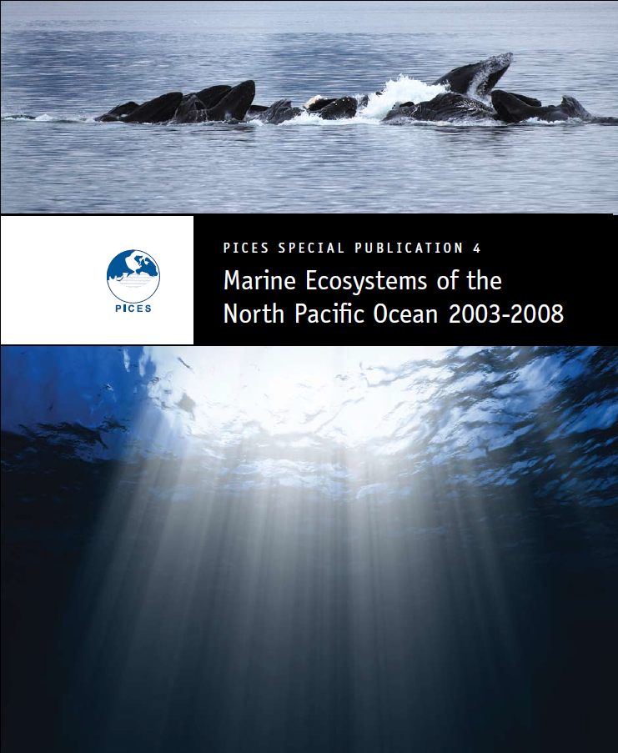
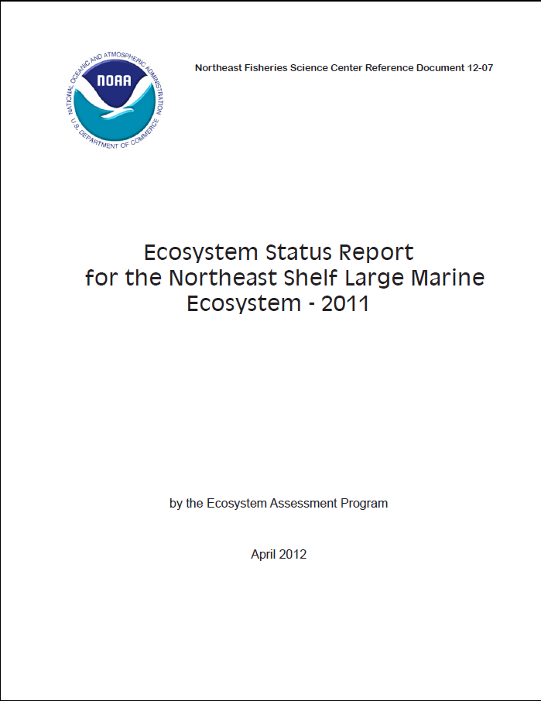
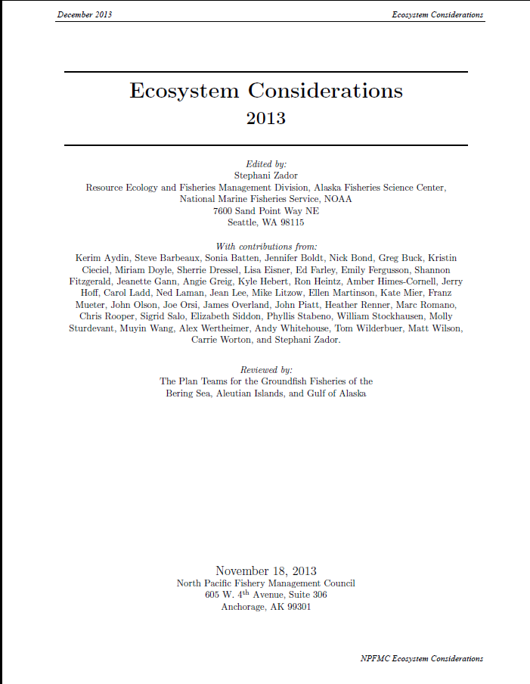
Many ecosystem indicators / status documents
http://www.nefsc.noaa.gov/publications/crd/crd1207/crd1207.pdf
Notes:
Stock assessments conducted annually for quota setting
Ecosystem considerations appendix to Stock Assessment and Fishery Evaluation documents since 1995
Ecosystem considerations in single species stock assessments since mid-2000s
Ecosystem assessment since 2005

Slide 28
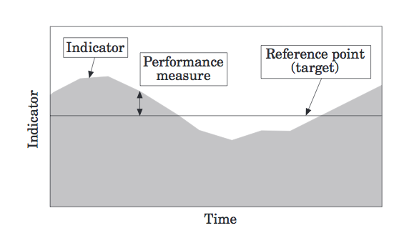
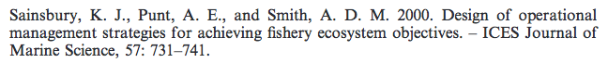
Monitoring ecosystem status relative to reference points

Slide 29
3. Achieving Ecosystem Goals
Implementation
Tools for Action
What do we need?
Decision Theory
Reference Points
Control Rules for Action

Slide 30
Tools to influence the direction of ecosystem change with respect to the fisheries sector
Effort controls
Catch controls
Time or Area management
Gear modifications
Technical controls
Access & property rights
Economic incentives
Social incentives

Slide 31
Decision Theory
Decision theoretic framework based upon the 3 pillars.
Relate indicator of status to specific action.
Look at single-species fisheries example.
Extrapolate to an ecosystem.
Requires quantitative metrics.

Slide 32
Translation of metrics into decision criteria
Reference points
B_{MSY}
B_{20% B-virgin}
F=M
K/2
r/2
B_{MAX}
B_{MSST}
F_{20%MSP}
F_{MSY}
50%YPR
F_{max}
F_{0.1}
B_{90% Surv.}

Slide 33
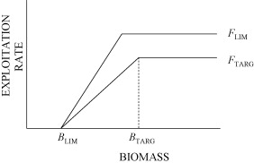
Single-species decision rule
Smith et al. 2008. Fisheries Research, 94, 373–379.

Slide 34
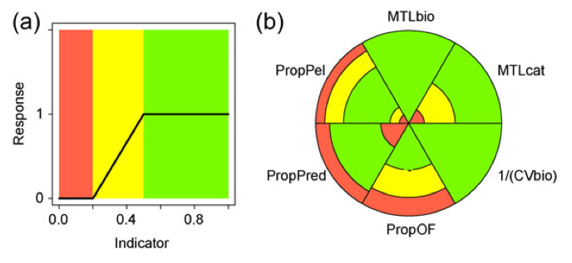
Can we translate typical control rules to the ecosystem level?

Slide 35
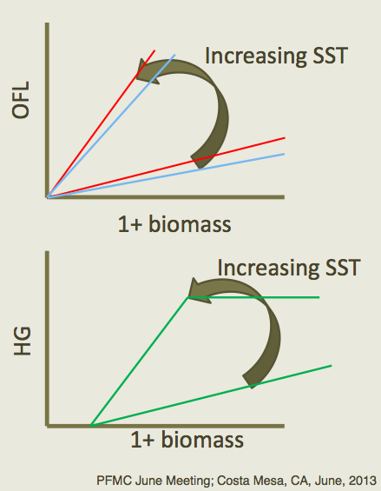
Can we translate typical control rules to the ecosystem level?
Modified single-species control rules that have included ecosystem considerations.
(e.g. Pacific sardine,
Hurtado et al.)
OR, Systemic control rules that are analogues to single-species versions.

Slide 36
Decision criteria
Single Species
Model & empirical-based ref. points
Empirical and model-based control rules
Action to be taken shows direction and magnitude
Ecosystem
Model & empirical-based ref. points & directions
Arbitrary / empirical / model-based control rules?
Action to be taken may only show direction
Emphasizing integrated, systemic view
RP
CR
RP
CR(p)
CR(q)
RQ/RP

Slide 37
Doing EBFM
Questions?

Slide 38
What’s Next?
Bycatch, habitat, spatial management, oh my!
Discussion on Marine Protected Areas:
Edgar et al. 2014
Hilborn et al. 2004
Lester et al. 2009
McCay & Jones 2011

